Slide 1
MOVIE REVIEW ANALYSIS BASED ON SENTIMENT USING TEXT PROCESSING API WITH IBM CLOUD
TEAM MEMBERS
THADEM HEMANTH KUMAR – 20R15A0221
THOUTA SHYAM SUNDER – 20R15A0223
AKIRI SAI SWETHA – 20R15A0224
BIJJULA PREM KUMAR REDDY – 20R15A0226
MODALI YAGNA LAKSHMI MADHURI – 20R15A0227

Slide 2
contents
ABSTRACT
INTRODUCTION
SENTIMENT ANALYSIS
APPLICATION PROGRAMME INTERFACE – API
FLASK APPLICATION
IBM CLOUD
CONCLUSION

Slide 3
ABSTRACT
Movie reviews help users decide if the movie is worth their time. A summary of all reviews for a movie can help users make this decision by not wasting their time reading all reviews. Movie-rating websites are often used by critics to post comments and rate movies which help viewers decide if the movie is worth watching. Sentiment analysis can determine the attitude of critics depending on their reviews. Sentiment analysis of a movie review can rate how positive or negative a movie review is and hence the overall rating for a movie. Therefore, the process of understanding if a review is positive or negative can be automated as the machine learns through training and testing the data. This project aims to rate reviews using two classifiers and compare which gives better and more accurate results. Classification is a data mining methodology that assigns classes to a collection of data in order to help in more accurate predictions and analysis. Naïve Bayes and decision tree classifications will be used and the results of sentiment analysis compared.

Slide 4
introduction
Movie reviews are an important way to gauge the performance of a movie. While providing a Numerical/stars rating to a movie tells us about the success or failure of a movie quantitatively, a collection of movie reviews is what gives us a deeper qualitative insight on different aspects of the movie. A textual movie review tells us about the strong and weak points of the movie and deeper analysis of a movie review can tell us if the movie in general meets the expectations of the reviewer.
Sentiment Analysis is a major subject in machine learning which aims to extract subjective information from the textual reviews. The field of sentiment of analysis is closely tied to natural language processing and text mining. It can be used to determine the attitude of the reviewer with respect to various topics or the overall polarity of review. Using sentiment analysis, we can find the state of mind of the reviewer while providing the review and understand if the person was “Positive”, “Negative”,” Neutral” and so on.

Slide 5
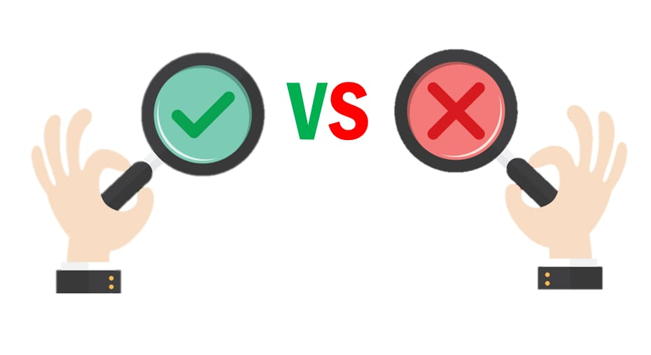

Slide 6
Sentiment analysis
Sentiment analysis is also known as opinion mining or emotion AI. It refers to the use of natural language processing text analysis, computational linguistics, and biometrics to systematically identify, extract, quantify, and study affective states and subjective information. Sentiment analysis is widely applied to voice of the customer materials such as reviews and survey responses, online and social media, and healthcare materials for applications that range from marketing to customer service to clinical medicine.
In this project we aim to use sentiment analysis on a set of movie reviews given by reviewers and try to understand what their overall reaction to the movie was, i.e. if they liked the movie or they hated It.We aim to utilize the relationships of the words in the review to predict the overall polarity of the review.

Slide 7
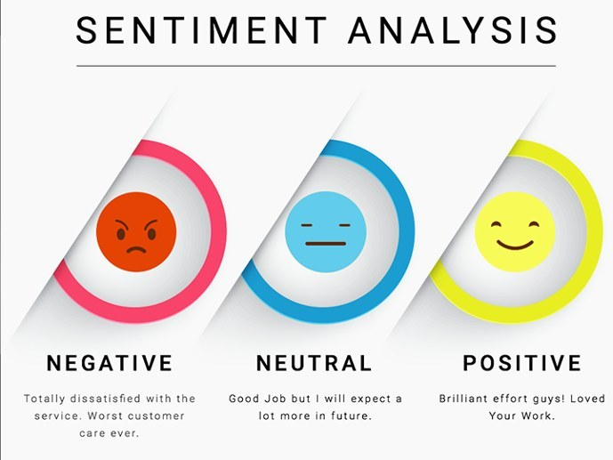

Slide 8
APPLICATION PROGRAMMING INTERFACE
In computing, an application programming interface (API) is an interface that defines interactions between multiple software applications or mixed hardware-software intermediaries
In building applications, an API (application programming interface) simplifies programming by abstracting the underlying implementation and only exposing objects or actions the developer needs.
The text-processing API is a simple JSON over HTTP web service for text mining and natural language processing. It is currently free and open for public use without authentication, though that may change in the future.

Slide 9
FLASK APPLICATION
Flask is a micro web framework written in Python. It is classified as a microframework because it does not require particular tools or libraries. It has no database abstraction layer, form validation, or any other components where pre-existing third-party libraries provide common functions. However, Flask supports extensions that can add application features as if they were implemented in Flask itself. Extensions exist for object-relational mappers, form validation, upload handling, various open authentication technologies and several common framework related tools.

Slide 10
IBM CLOUD
IBM Cloud provides a full-stack, public cloud platform with various products in the catalog, including options for compute, storage, networking, end-to-end developer solutions for app development, testing and deployment, security management services, traditional and open source databases, and cloud-native services. Scalability. Cloud infrastructure scales on demand to support fluctuating workloads . Storage options. Users can choose public, private or hybrid storage offerings, depending on security needs and other considerations. Control choices. ... Tool selection. ... Security features.

Slide 11
CONCLUSION
This process of text processing, sentiment analysis is not only used for movie reviews but for other purposes like in taxi service apps like ola, uber, rapido, etc after completion of the ride we will be asked for a review of the driver, ride and the app. In online shopping sites we will be asked about the product. Now a days this process is entering our daily lives in every aspect.
From this project we have learnt about:
API
IBM CLOUD
FLASK APPLICATION
SENTIMENT ANALYSIS.

Slide 12
Thank you

